Slide 1
Software Inspection
Lecture 6b
Madiha Malik

Slide 2

Software Inspection
Inspection in software engineering, refers to peer review of any work product by trained individuals who look for defects using a well defined process. An inspection might also be referred to as a Fagan Inspection (i-e; is a structured process of trying to find defects in development documents such as programming code, specifications, designs and others during various phases of the software development process)

Slide 3
Software Inspection
Involve people examining the source representation with the aim of discovering anomalies and defects.
Do not require execution of a system so may be used before implementation.
May be applied to any representation of the system (requirement, design, test data, etc.)
Very effective technique for discovering errors.

Slide 4
Inspection success
Many different defects may be discovered in a single inspection.
In testing, one defect may mask another so several executions are required.
They reuse domain and programming knowledge, so reviewers are likely to have seen the types of error that commonly arise.

Slide 5
Program Inspection
Formalized approach to document reviews.
Intended explicitly for defect detection (not correction)
Defects may be logical errors, anomalies in the code that might indicate an erroneous condition (e.g. an uninitialized variable) or non-compliance with standards.

Slide 6
Inspection Pre-conditions
A precise specification must be available
Team members must be familiar with the organisation standards
Syntactically correct code must be available
An error checklist should be prepared
Management must accept that inspection will increase costs early in the software process
Management must not use inspections for staff appraisal

Slide 7
Inspection Checklists
Checklist of common errors should be used to drive the inspection
Error checklist is programming language dependent
The 'weaker' the type checking, the larger the checklist
Examples: Initialisation, Constant naming, loop termination, array bounds, etc.

Slide 8
Fault Class | Inspection Checks
Data Faults | Are all program variables initialized before their values are used? Have all constants been named? Should the upper bound of arrays be 0,1, or something else? Should the upper bound of arrays be equal to the size of the array or size-1? If character strings are used, is a delimiter explicitly assigned?
Control Faults | For each conditional statement, is the condition correct? Is each loop certain to terminate? Are compound statements correctly bracketed? In case statements, are all possible cases accounted for?
Input/Output Faults | Are all input variables used? Are all output variables assigned a value before they are output?
Interface Faults | Do all functions and procedure calls have the correct number of parameters? Do formal and actual parameter types match? Are the parameters in the right order? If components access shared memory, do they have the same model of the shared memory structure?
Storage Management Faults | If a linked structure is modified, have all links been correctly reassigned? IF dynamic storage is used, has space been allocated correctly? Is space explicitly de-allocated after it is no longer required?
Exception Management Faults | Have all possible error conditions been taken into account?

Slide 9
Exercise 1
_{// AddTwoNumbers.cc}
_{#include <iostream.h>}
_{using namespace std;}
_{int main()}
{
_{int a, b, total ;}
cout << "Input numbers to be added: " << endl;
_{cin >> a >> b ;}
_{b = a + total ;}
cout << "The sum is " << total << endl;
_{return 0; }}

Slide 10
Solution for Exercise 1
int a, b, total ;
cout << "Input numbers to be added: " << endl;
cin >> a >> b ;
b = a + total ;
cout << "The sum is " << total << endl;
Wrong assignment of variables
Data Fault

Slide 11
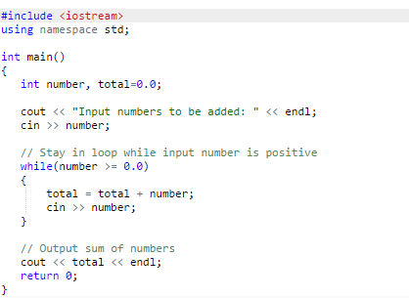
Exercise-2
//Computes the sum of numbers input // The input is terminated when input number is negative.

Slide 12
Solution for Exercise-2
Data type of number and total is not same

Slide 13
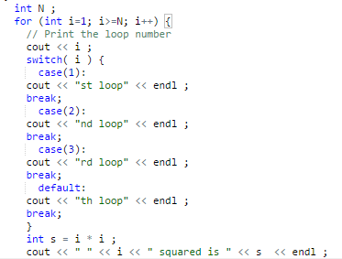
Exercise 3
//Print square value of first 10 numbers

Slide 14
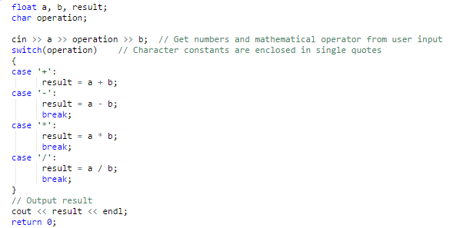
Exercise 4
//Simple Arithmetic Calculator

Slide 15
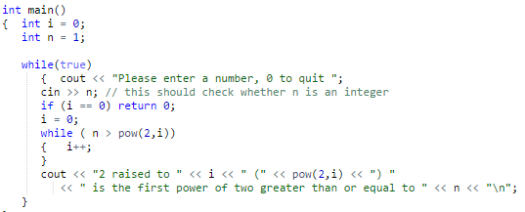
Exercise-5
//compute the first integral power to which 2 can be raised that is greater than a user input.

Slide 16
Copy and paste the following code in eclipse IDE and check the errors/warning issued
import java.util.Scanner;
//import junit.framework.*;
public class bsse {
/**
* @param args
*/
public static void main(String[] args) {
// TODO Auto-generated method stub
System.out.println("Hello world");
Scanner input = new Scanner (System.in);
int operand=input.nextInt();
System.out.println(operand);
String name;
System.out.println(name);
do{
name=input.next();
System.out.println(name);
break;
System.out.println(operand);
}
while (true);
System.out.println(name);
//input
}
}
Do you think that compiler of eclipse IDE performs static analysis before every build to run the code?? Study about the LINT static analysis.

